Slide 1
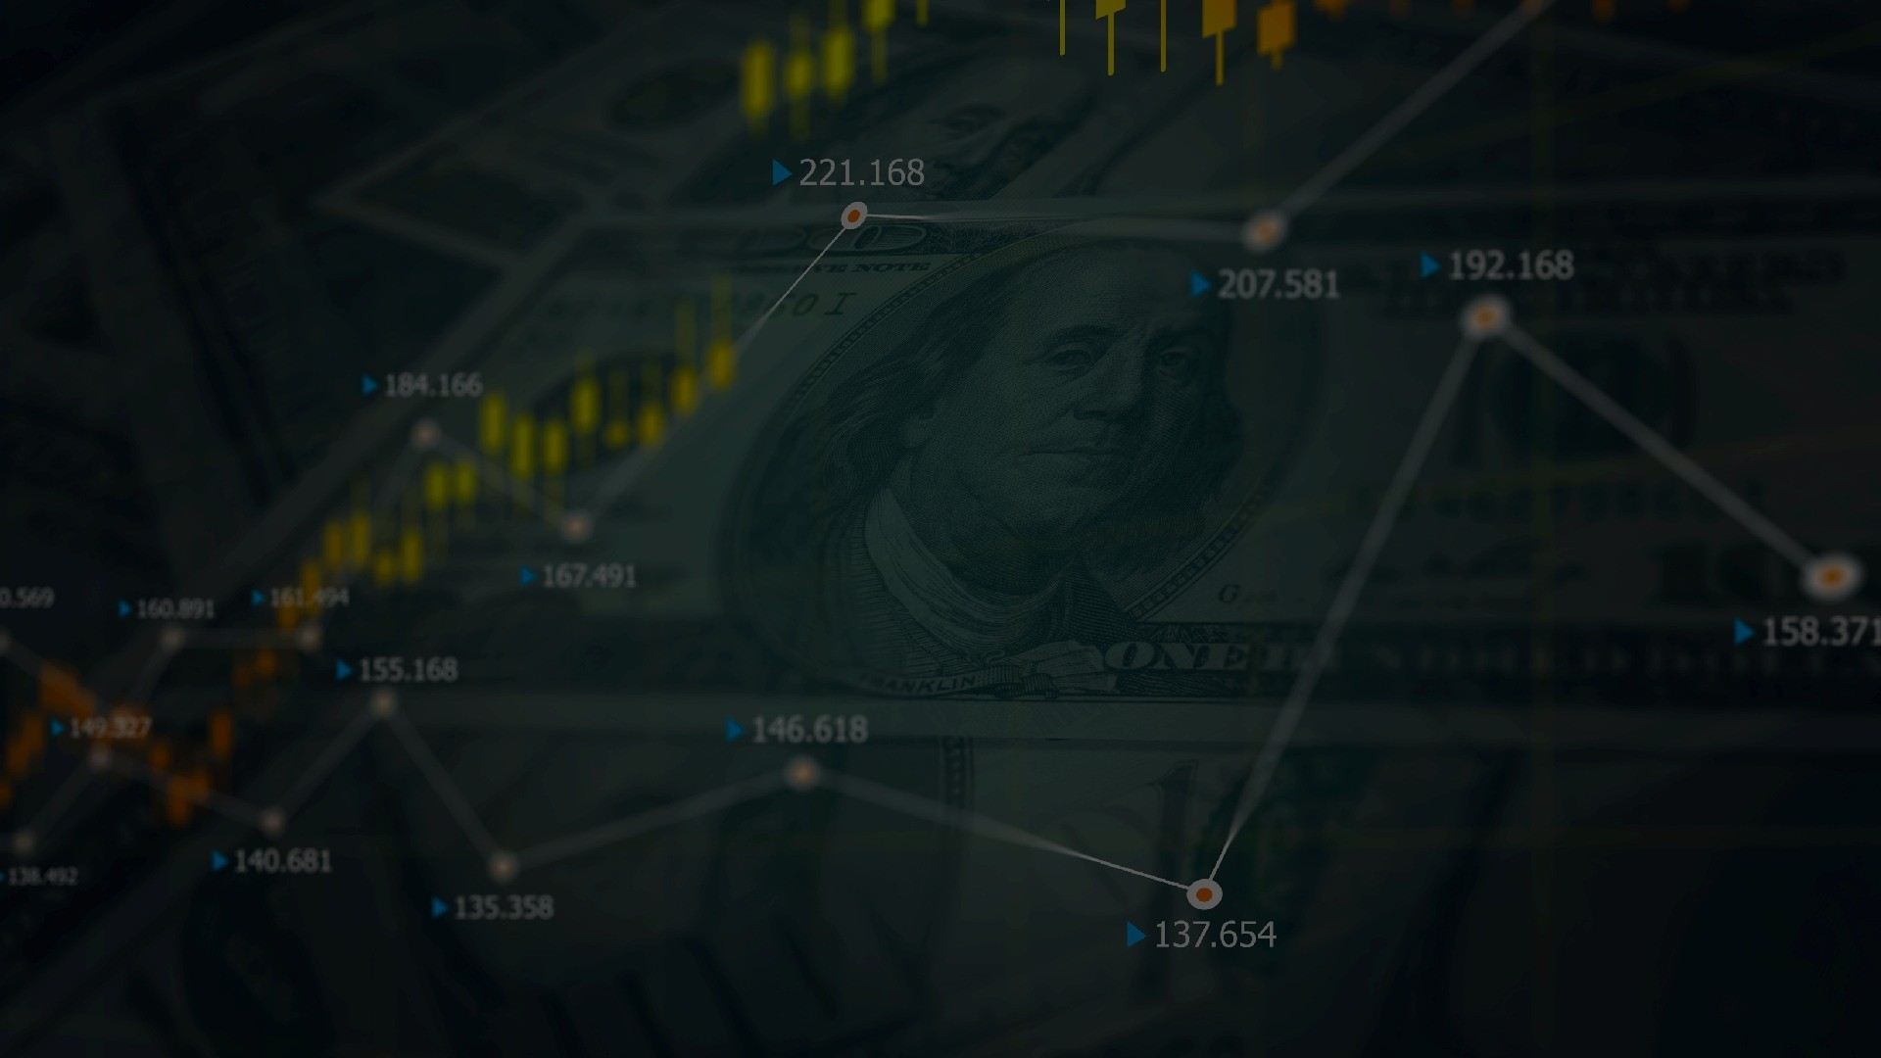


KAVIKULGURU INSTITUTE OF TECHNOLOGY AND SCIENCE RAMTEK 440016
Department of Computer Technology 2022-2023
Design And Implementation Of Web-Application
On
Learning Stock Market Exchange

Slide 2
Presented By:
Mr. Aditya Darne – CT20050 Ms.Sakshi Poshattiwar – CT20092 Ms. Vaishnavi Puttewar - CT20058 Ms. Janhvee Barai – CT20068
Ms. Sanskruti yarwar – CT20038
Guided By:
Ms Anagha Darokar (Asst. prof. )

Slide 3


CONTENT
Introduction Problem statement Problem objective Literature review
Proposed approach and system Architecture Implemented work
Result and Discussion Conclusion
Future scope References

Slide 4

Introduction
Due to the high profit of the stock market ,it is one of the most popular investment. The problem of stock market exchange and price analysis involves:
Two stock exchanges namely- the national stock exchange (NSE) and the Bombay stock exchange (BSE), which are the most of the trading in Indian stock market takes place.
Sensex and Nifty are the two prominent indian market indexes. Since the prices in the stock market are dynamic , the stock market prediction is complicated.
For investigation trends, pattern and cycle or period the analysis of time series advantages in the present data.
In spending money wisely an early data of a bullish or bearish in case of the stock market. Also , for categorizing the best –performing companies.

Slide 5
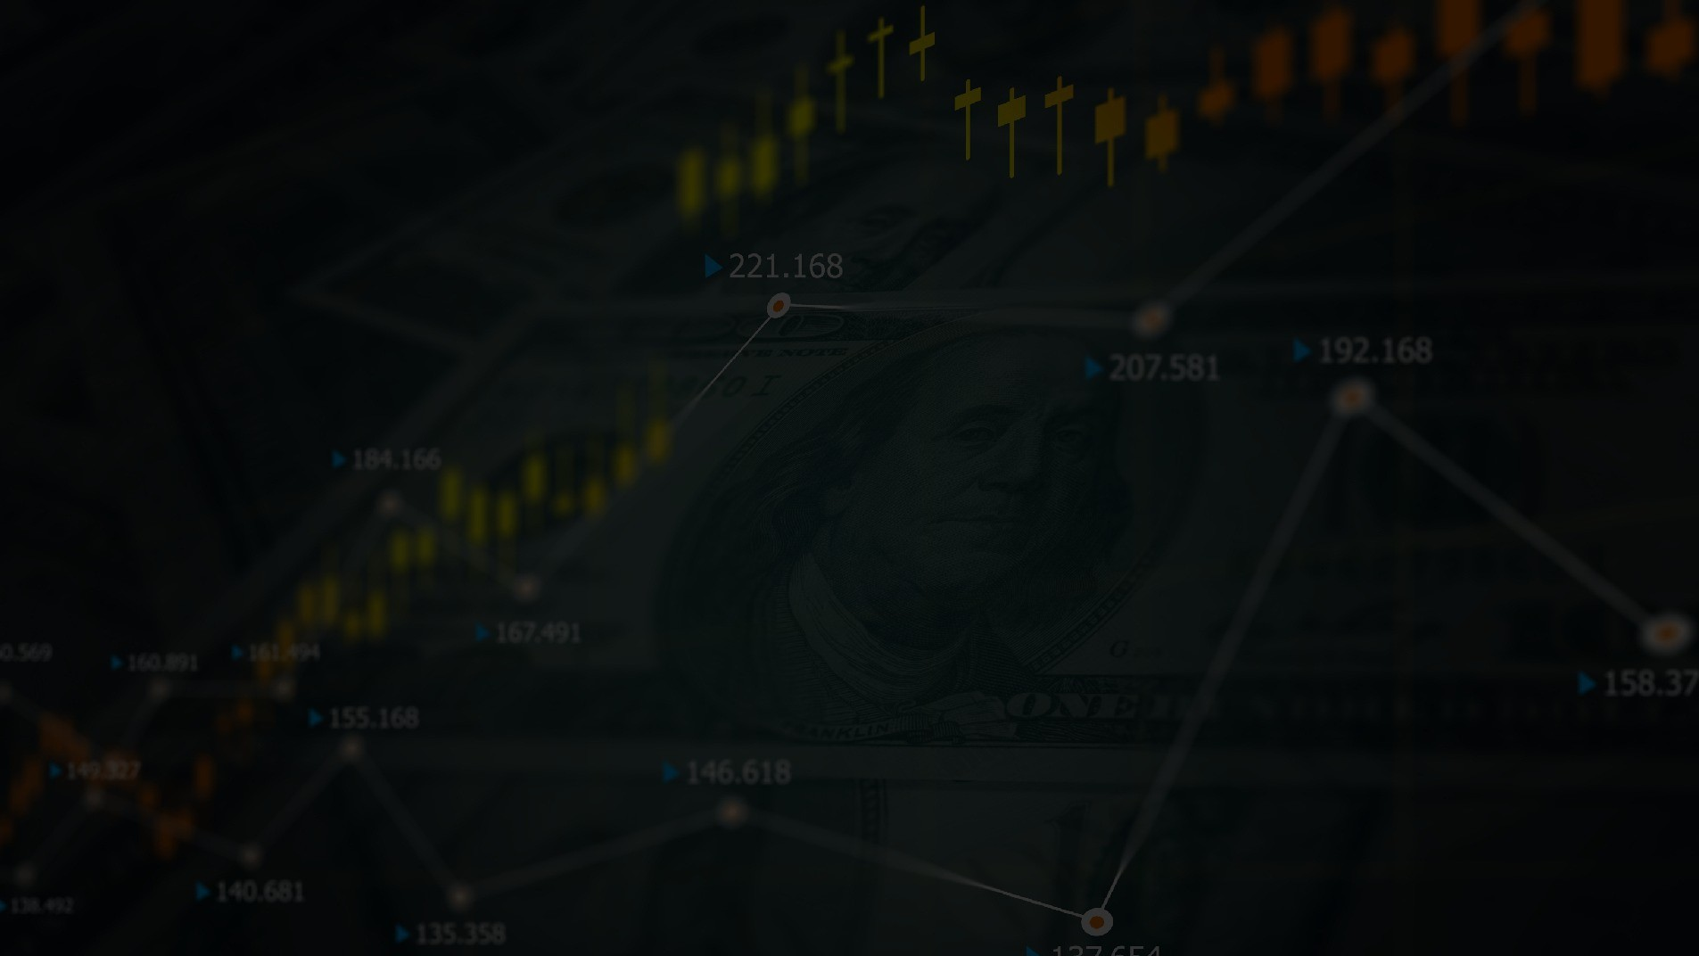
Problem statement
The problem of stock market exchange and price analysis involves:
The challenge of using various techniques to analysis and interpret stock market data to make informed investment decision .
This problem includes issues such as identifying and tracking market trends, predicting future price movements
Identifying undervalued or overvalued stocks.It also includes challeges such as dealing with market volatility, incorporating macroeconomic factors, and managing risk.
Additionally, technological advancements have brought about new challenges ,such as the need to process and analysis large amount of data and respond quickly to market changes.

Slide 6

Problem objectives
Design a mobile/web application that enables users to buy ,sell and monitor their investments in various financial instruments such as stock’s, mutual funds , and exchange-traded funds(ETFs).
The app should have a user –friendly interface that allows users to quickly view their portfolio, track market trends and execute trades.
Explore stock prices.
Implement basic model using linear regression. Compare the result and submit the report.

Slide 7

Literature review
sr no
1
2
3
4
Title
Aggregate Economic Variables and Stock Markets in India
Environment al factors Influencing Fluctuation of
Share prices on Nigeria Stock Exchange Market.
Analysis the Determinants of Market Stock Price Movements: An Empirical
Study of Jordanian Commercial Banks
Empirical Evidence of the Existence of Investable
Premiums in Emerging Market Investable Stocks
Author
Ahmed, S
Guru, U.Idris I.
Nasif AL,F.Shubiri
Girard, EC.
Year
2008
2009
2010
2010
Description
Movement ofstock prices is not only
affected by key macro economic variables but also influenced by other macro
dimensions in the economy
Stock prices moves in the same direction with GDP, money supply, total deficit & interest rate while inflation rate & index of industrial moves in opposite direction.
Highly positive relation between Market Price of Stock & NAVPS , Dividend
percentage, & Gross Domestic Product. Negative relationship on inflation and lending interest rate
The average return and volatility of more investable stocks is greater than the
average return of less investable stocks.

Slide 8

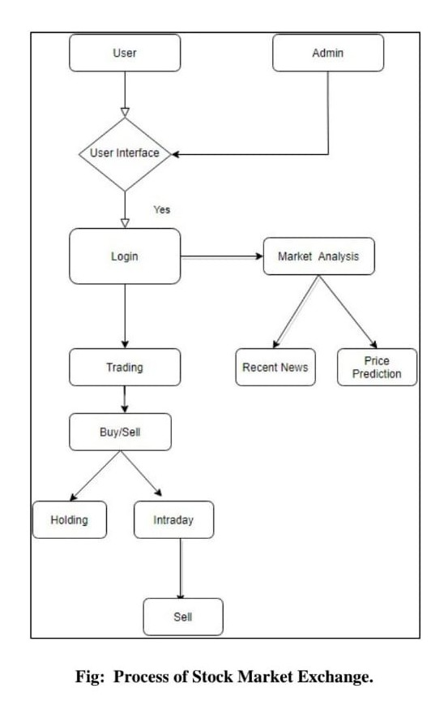
PROPOSED APPROCH AND SYSTEM ARCHITECTURE:

Slide 9
PLAN OF IMPLEMENTATION
const constants = require("../constants");
const usersController = require("../controllers").usersController;
module.exports = (app, pool) => {
// api routes
app.get('/users', async (req, res) => {
try {
let users = []
users = await usersController.getUsers(pool);
res.send(users)
} catch (err) {
res.status(500).send(err)
}
})
app.post('/register', async (req, res) => {
try {
const user = await usersController.register(req.body, pool)
res.send(user)
} catch (err) {
res.status(500).send(err)
}
})
app.post('/login', async (req, res) => {
try {
const user = await usersController.login(req.body, pool)
res.send(user)
} catch (err) {
if (constants.hasOwnProperty(err)) {
res.status(err).send(constants[err])
} else {
res.status(500).send(err)
}
}
})
}

Slide 10
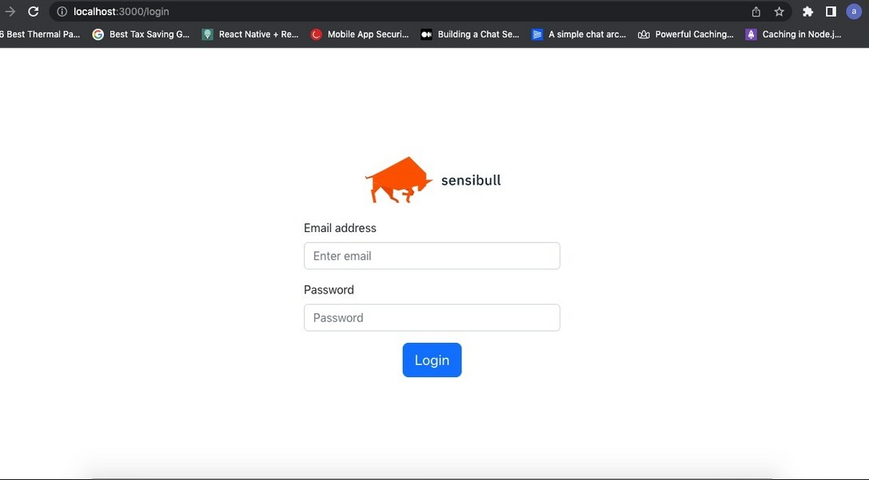
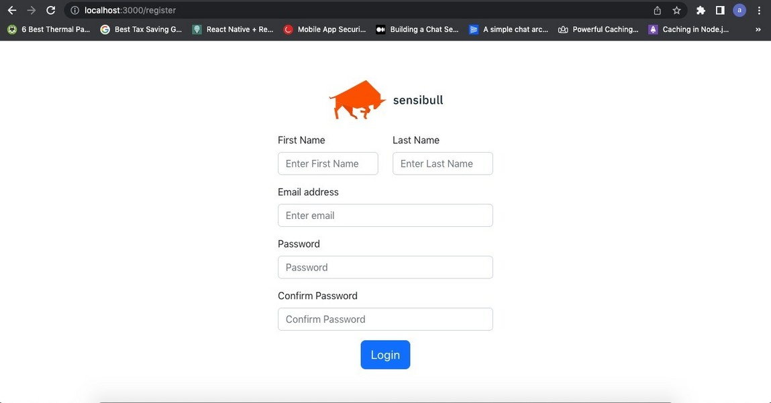
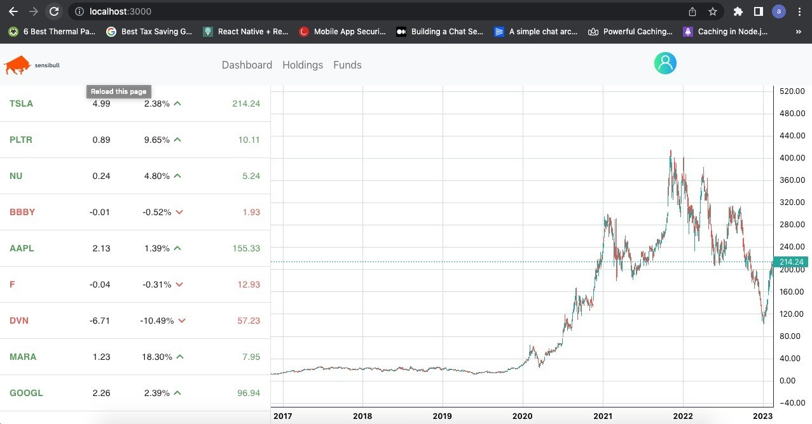
RESULT AND DISCUSSION

Slide 11
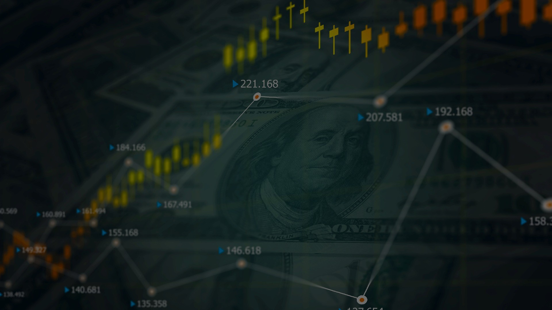
CONCLUSION
Stock Market is the mitigation of risk through the spreading of investments across multiple entities, which is achieved by the pooling of a number of small investments into a large bucket. Stock Market is the most suitable investment for the common man as it offers an opportunity to invest in a diversified,professionally managed portfolio at arelativily low cost. the review of literature has brought to light that:
Enlistment of corporate securities in more than one stock exchange at the same time improves liquidity of securities and functioning of stock exchange.
There is existence of wild speculation in the Indian stock market.
Risk is not measurable or quantifiable But risk is calculated on the basis of historic volatility
Stock market movements are largely influenced by , broad money supply, inflamationn, C/D ratio and fiscal deficit apart from political stability.
Low execution costs make the derivaitives especially futures, very suitable for frequent and short term trading to manage risk, more effectivily.

Slide 12
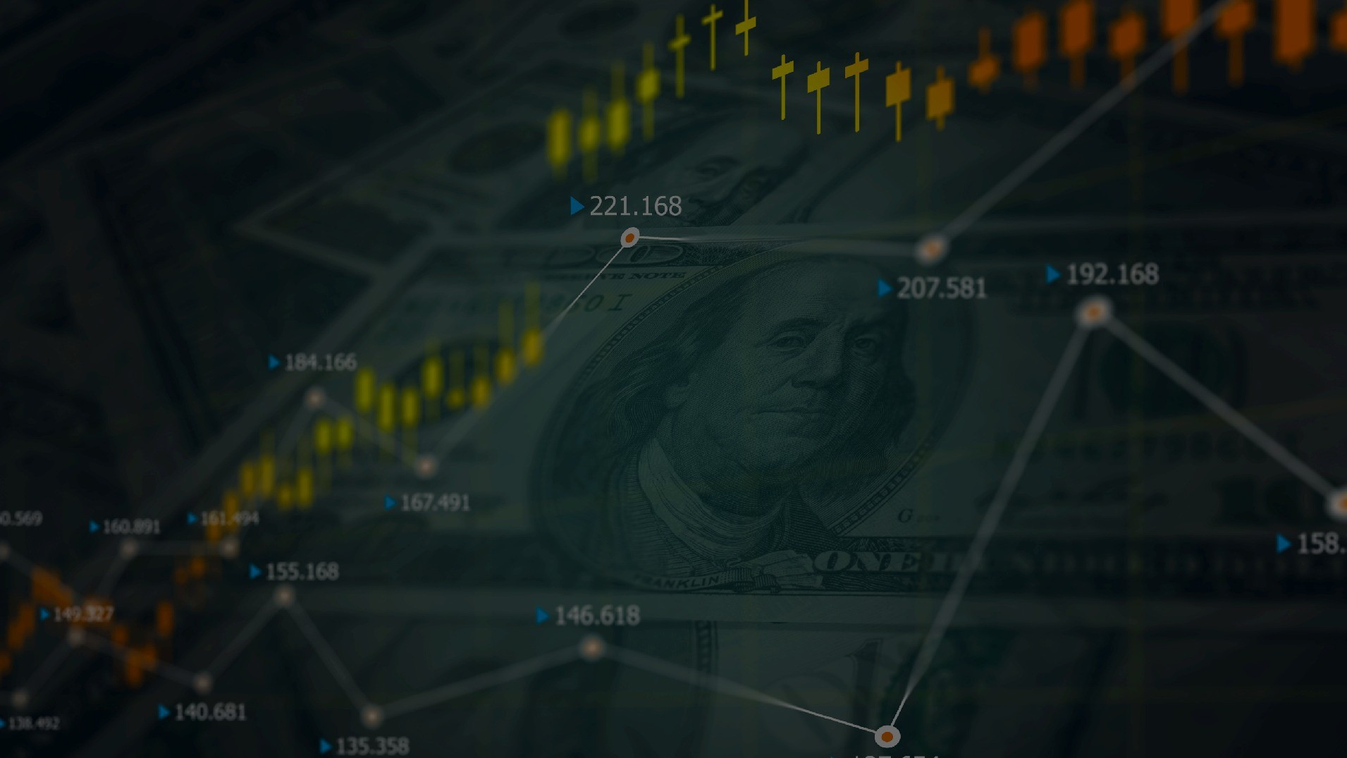
FUTURE SCOPE
The future scope of stock market exchange is quite promising. With the advancements in technology and the increasing adoption of digital platforms, the stock market exchange is expected to become more efficient, transparent, and accessible.
Expansion of Global Markets: The stock market exchange is expected to expand globally, allowing investors to trade in markets beyond their geographical boundaries.
Integration of Blockchain Technology: The integration of blockchain technology can increase the transparency and security of transactions in the stock market exchange.
Overall, the future of the stock market exchange looks promising as it continues to evolve and adapt to changing market conditions and technological advancements.

Slide 13


References
Ahmed, Shahid. "Aggregate economic variables and stock markets in India." International Research Journal of Finance and Economics 14 (2008): 141-164.
Gunu, U. and Idris, I.O., 2009. Environmental factors influencing fluctuation of share prices on Nigeria stock exchange market. African Research Review, 3(5).
Faris Nasif, AL-Shubir. "Analysis the Determinants of Market Stock Price Movements: An Empirical Study of Jordanian Commercial Banks International." Journal of Business and Management Vol 5 (2010).
Girard, E.C., 2010. Empirical Evidence of the Existence of Investable Premiums in Emerging Market Investable Stocks. Financial Review, 45(4), pp.1025-1051.

Slide 14

Thank You!!!

